Slide 1
An Introduction to Database
Introduction to Database for Undergraduate Study
Lecture 5
SQL
SQL Types
SELECT Statement
DDL
This lecture and its associated materials have been produced by Mr. Rohit Panday (M.Sc. IT, 10+ Years of Industry/Academic Experience) of iAcademy for the purposes of lecturing on the above described subject and the material should be viewed in this context. The work does not constitute professional advice and no warranties are made regarding the information presented. The Author and iAcademy do not accept any liability for the consequences of any action taken as a result of the work or any recommendations made or inferred. Permission to use any of these materials must be first granted by iAcademy.

Slide 2

SQL
SQL (Structured Query Language) is a special-purpose programming language designed for managing data held in a relational database management system (RDBMS), or for stream processing in a relational data stream management system (RDSMS)

Slide 3

ANSI
A standardization that says,
SQL is a standard, i.e.
can be used in different databases

Slide 4
History of SQL
Dr. Codd published the paper “A Relational Model of Data for Large Shared Data Banks” in 1970
In 1979, Relational Software Inc. (now Oracle) introduced the first commercially available implementation of SQL
The language Structured English Query Language (SWQUEL) was developed by IBM to use Cod’s Model

Slide 5
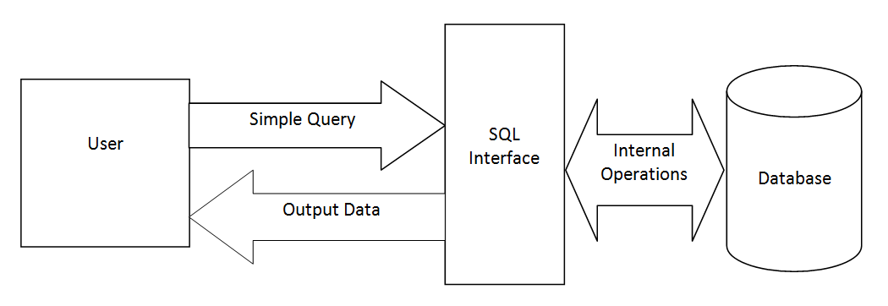
SQL - Uses
Update data on a Database
Retrieve data from a Database
It is the standard language for
relational database management systems

Slide 6
SQL - Category
DDL
Data Definition Language
DML
Data Manipulation Language
TCL
Transaction Control Language
DCL
Data Control Language

Slide 7
SQL - Category
DDL
CREATE, DROP, ALTER
DML
SELECT, INSERT, UPDATE, DELETE
TCL
COMMIT, ROLLBACK
DCL
GRANT, REVOKE

Slide 8
SQL - DDL
Data Definition Language or Data Description Language is used to build and modify the structure of tables and other objects of database.
Database Objects can be
  Tables
  Views
  Keys (constraints)
  Index

Slide 9
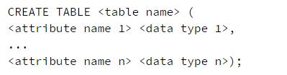
SQL – DDL - CREATE
CREATE statement
CREATE TABLE student (
id NUMBER,
name VARCHAR
dob DATE
);
KEYWORD
Variable
Data Type
Syntax to Create TABLE

Slide 10
SQL – DDL - ALTER
ALTER statement
ALTER TABLE student
ADD COLUMN marks number;
ALTER TABLE <table name>
ADD COLUMN <column name> <data type>
Syntax to Alter TABLE

Slide 11
SQL – DDL - ALTER
ALTER columns
ALTER constraints

Slide 12

SQL – DDL - ALTER
Syntax 1
Syntax 2

Slide 13
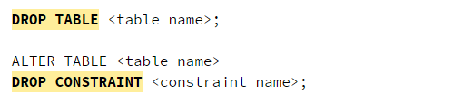
SQL – DDL - DROP
DROP statement
Drops table
Syntax to DROPTABLE
Drops Constraint from Table

Slide 14

SQL – DML - SELECT
The SELECT statement is used to fetch data from database
Multiple tables can be used separated by comma
You can fetch one or more fields in a single SELECT command
You can specify asterisk(*) in place to fields to select all fields
You can specify condition using where clause
Offset - starts from 0
Limit – limits the number of returns
Generic Syntax of SELECT

Slide 15
Key Points

Slide 16
Laugh

Slide 17

End of Lecture for Week - 5

